Slide 1
ChatGPT in Rasa
Ying shen
School of software engineering
tongji university

Slide 2
ChatGPT training process
Notes:
ChatGPT的关键能力来自三个方面：强大的基座大模型能力（InstructGPT），高质量的真实数据（干净且丰富），强化学习（PPO算法）。训练流程主要分成三步：第一步，使用有监督学习方式，基于GPT3.5微调训练一个初始模型；第二步，收集相同上文下，根据回复质量进行排序的数第三步，使用PPO强化学习策略来微调第一阶段的模型据；

Slide 3
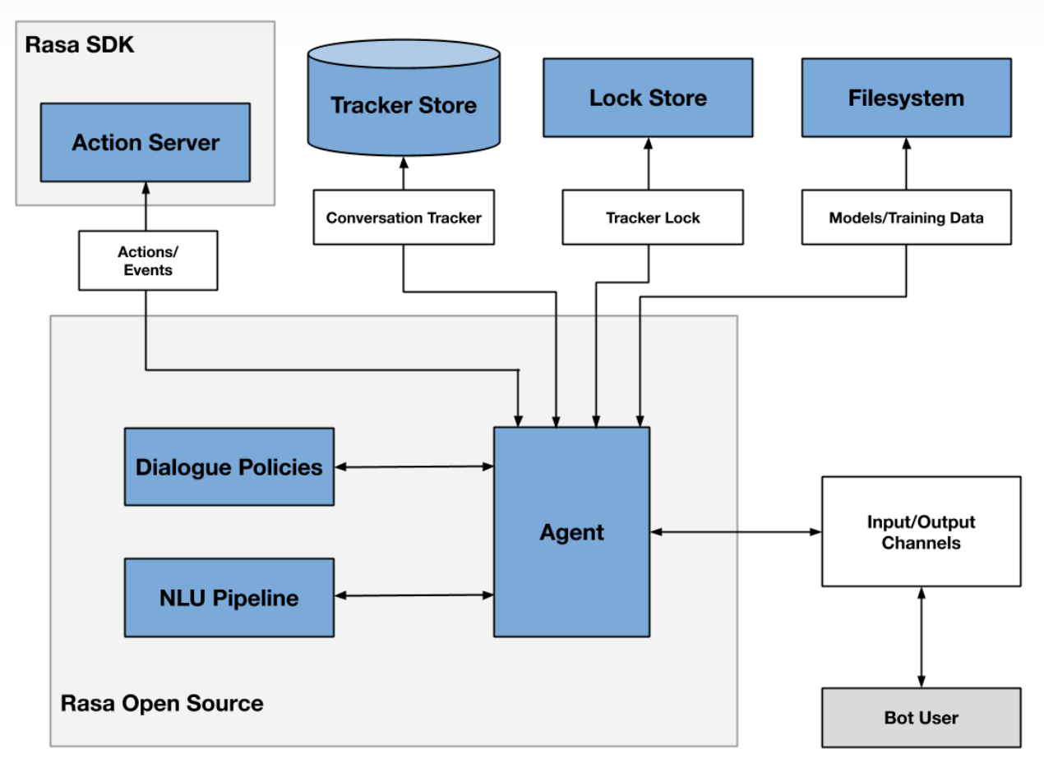
Rasa framework
Notes:
Rasa是一种开源的自然语言处理框架，可用于构建聊天机器人和智能语音助手。它提供了一系列工具和库，可以帮助开发者设计和训练自然语言处理模型，从而实现自动化对话。两个主要组件是自然语言理解 (NLU) 和对话管理。

Slide 4
Steps to call ChatGPT API in Rasa
You should follow the steps below to use ChatGPT and its API in Rasa:
download ChatGPT Desktop App (Not required when calling the API)
register
install openai
acquire your APIKEY
install rasa
create rasa project
call&run ChatGPT API in rasa project

Slide 5
Download ChatGPT Desktop APP
Select the version corresponding to your computer to download the desktop program：
macOS: https://github.com/lencx/ChatGPT/releases/download/v0.10.1/ChatGPT_0.10.1_x64.dmg
Windows: https://github.com/lencx/ChatGPT/releases/download/v0.10.1/ChatGPT_0.10.1_x64_en-US.msi
Linux: https://github.com/lencx/ChatGPT/releases/download/v0.10.1/chat-gpt_0.10.1_amd64.deb

Slide 6
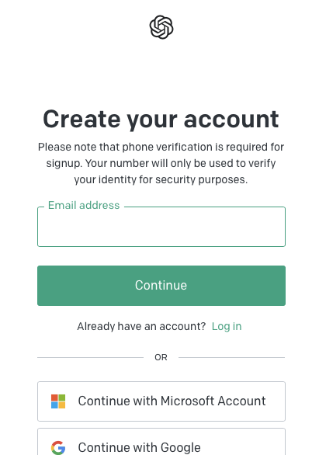
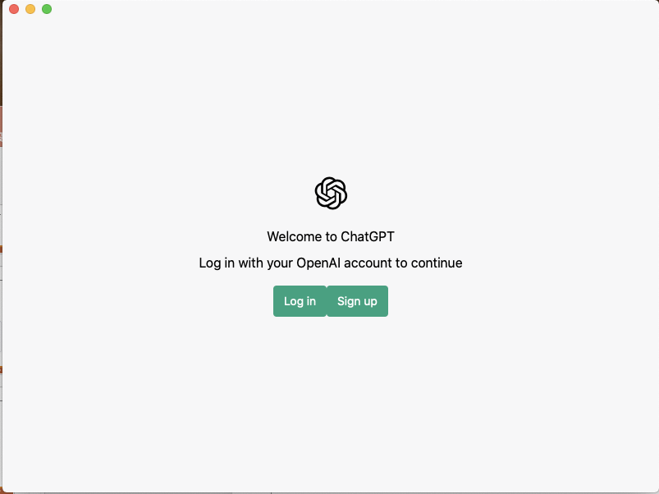
Register
When you open the desktop program for the first time, you need to register an account(You must connect to the VPN first, and note that the same IP cannot register more than 2 accounts)：

Slide 7

Register
When you open the desktop program for the first time, you need to register an account：

Slide 8
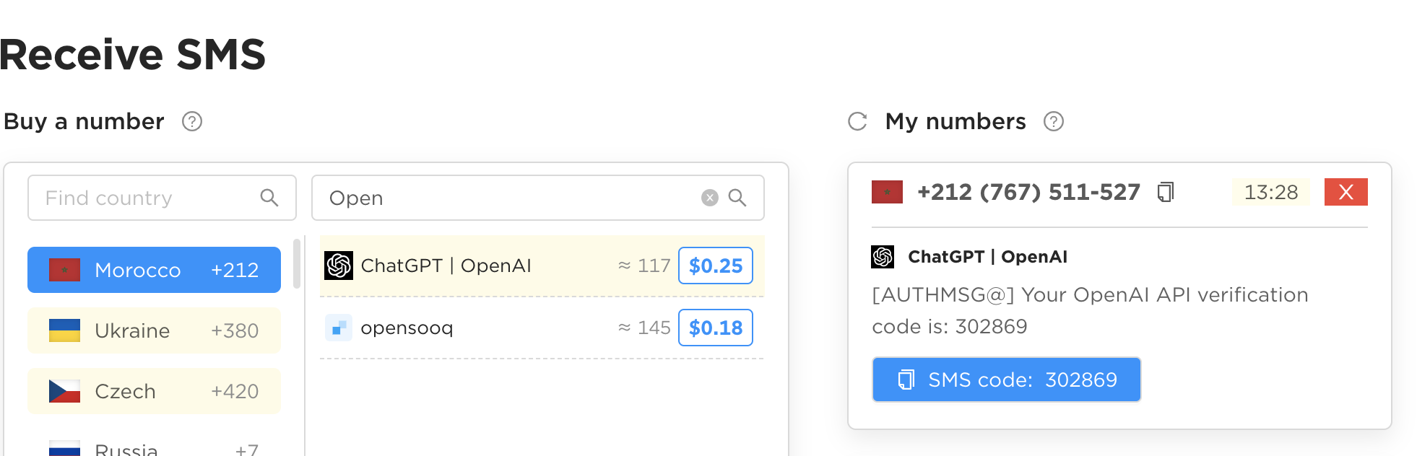
Register
A foreign mobile phone number is required to receive the verification code (not in Russia)：
Virtual phone number purchase website ：onlinesim.io
The site to buy is OpenAI
Notes:
需要使用国外的手机号接受验证码，onlinesim这个网站提供了手机号购买，有两个要注意的，不要买俄罗斯的，同时要买OpanAI这个站点的，找便宜的以及还有容量的买就可以了

Slide 9
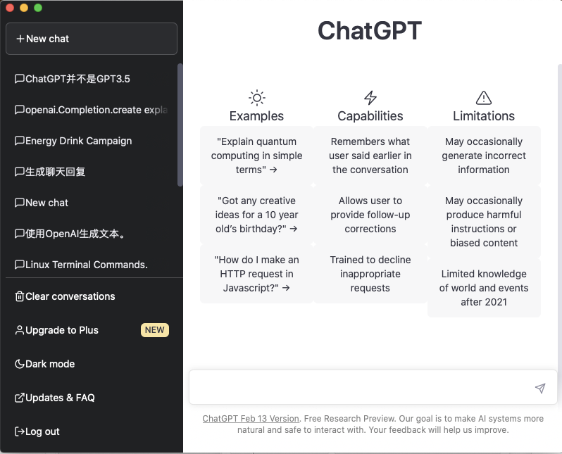
Register
Notes:
登录之后桌面程序就是这样的，但是这个不是很稳定，如果一段时间中没有交互，就需要重启应用

Slide 10

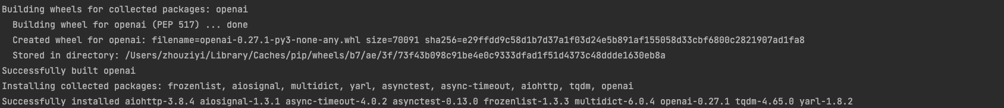
Install openai

Slide 11
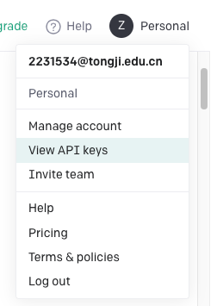
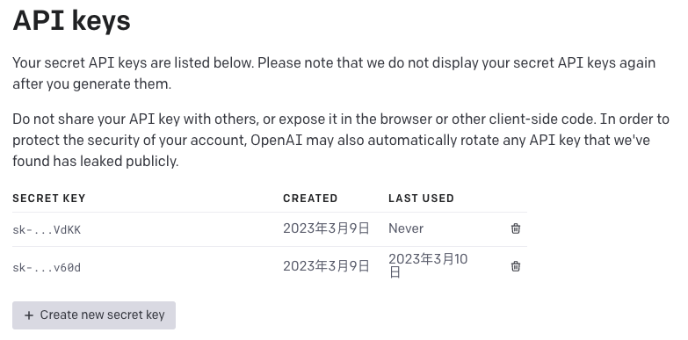
Acquire your APIKEY
Notes:
要申请自己的API KEY才可以调用API，注意每个月使用使用上限的

Slide 12

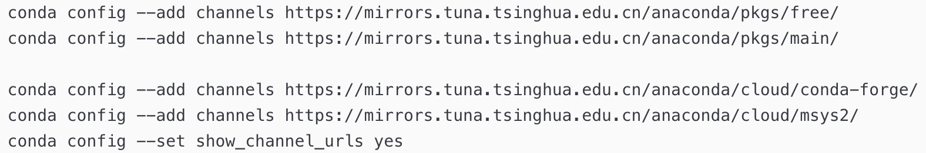
Install Rasa
Use VPN to make your installation faster, or configure Tsinghua mirror source：
Notes:
Rasa的安装也比较简单，可以在打开VPN的情况之直接用pip安装，也可以切换清华源安装

Slide 13
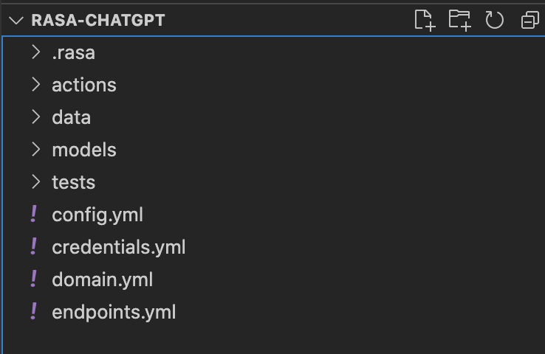
Create Rasa project
It is recommended to use VSCode to build the Rasa project, of course you can also choose Pycharm：
Create a new folder and open it in VSCode
Enter in the terminal of VSCode:
rasa init
You can find more explanations about these files in the search engine
Notes:
建议在VXCode中使用Rasa，打开VSCOde中的终端输入rasa init就可以创建出一个rasa的项目

Slide 14
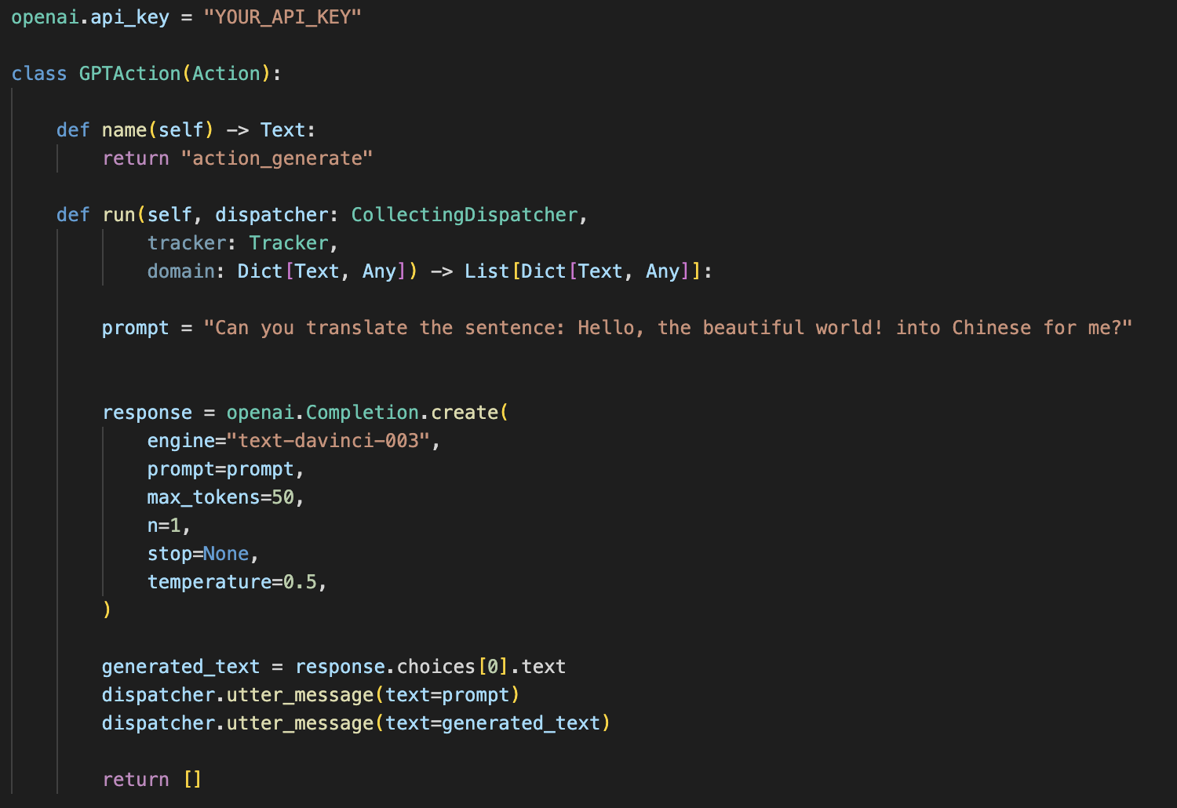
Call ChatGPT API in the rasa project
The sample code provides a simple self-defined operation to call the ChatGPT API code:
自定义的操作的名称
This class should be added to action.py
Notes:
调用ChatGPT的API需要自定义一个操作，这个操作写在actions/action.py中，在其中给出你的API_KEY以及你的prompy，示例程序中使用的enging是davinvi，是用于各类文本生成。最后使用utter_message把你的prompt和回复打印到控制台中

Slide 15
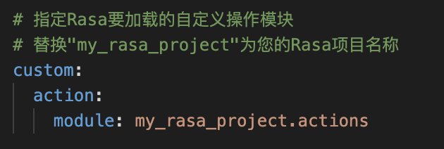
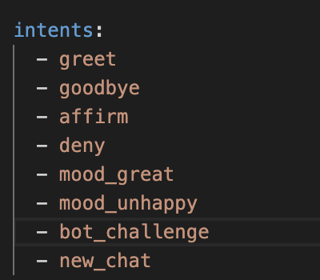
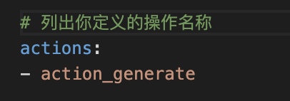
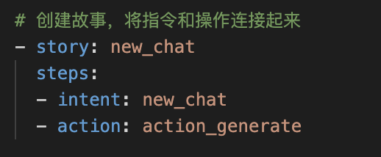
Call ChatGPT API in the rasa project
config.yml
domain.yml
stories.yml
将定义的指令添加进list
Notes:
定义了操作之后需要在各个yml文件中添加触发器，要在config.yml中加载操作，要在domain.yml中添加你的操作和指令，在stories.yml中将操作和指令连接起来

Slide 16
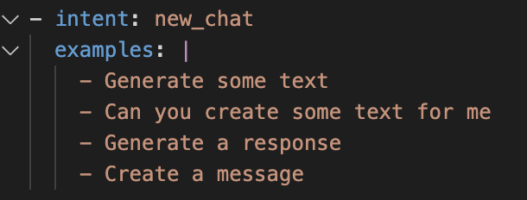

Call ChatGPT API in the rasa project
nlu.yml
endpoint.yml
Notes:
在nlu.yml中定义指令的内容，同时在endpoint.yml中添加自定义操作的API端点配置

Slide 17
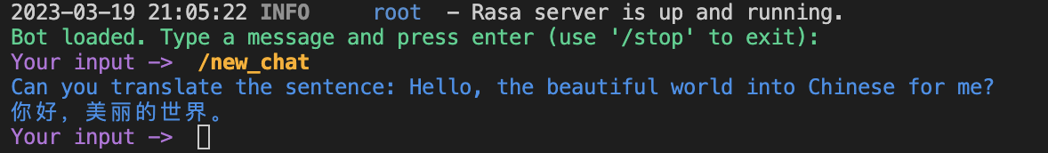
Run rasa project
rasa train
rasa run actions (run in a terminal)
rasa shell --endpoints endpoints.yml (run in another terminal)
There are more functions in Rasa that you can try according to your needs, but as long as you meet the requirements of the assignment, you can get full marks.
Notes:
要运行rasa项目首先需要train一个Rasa的模型，只要更改了yml文件就需要重新训练模型。然后建议先打开一个终端运行rasa run actions，这个指令启动的是Rasa SDK Server，它用于开发自定义的组件和自定义行为。然后再打开一个终端运行rasa shell，并指定运行端点在特定的yml文件中加载。这个指令运行了rasa server，他是用于接收来自用户的请求的。这两个终端进行交互，也就是说，当用户与 Rasa Server 交互并发出一个请求时，Rasa Server 将该请求传递给 Rasa SDK Server，后者将处理该请求并返回响应，然后 Rasa Server 将响应返回给用户。
运行后可以看到一个简单的结果，就翻译了我们指定的那句话。
当然Rasa有更多的功能，感兴趣可以试试，但只要完成了作业要求，就能拿到满分。

Slide 18
Assignment
Try to compare the difference and connection between openai.Completion.create and openai.ChatCompletion.create
Try to test different models and compare: https://platform.openai.com/docs/models
Design your prompts to accomplish the following tasks in rasa:
When your favorite puppy or kitten passed away, you felt a deep sense of loss and longing for it. You would like ChatGPT to help you simulate its presence. Please describe its behavior and personality so that ChatGPT can better emulate it. Also, please create your first request to ChatGPT.
Let ChatGPT become a copywriter for WeChat Moments. Please make a request to this editor in the prompt. For example: 'Please use your imagination to the fullest', 'Please express in a literary way', or 'Please express in an indirect way'. Also, please provide your first instruction, such as describing the mood you want to convey or what kind of image you want to match.
Some examples of prompts are listed here for reference: https://github.com/f/awesome-chatgpt-prompts

Slide 19
Report
The report should answer the following questions (in English):
1. The difference and connection between openai.Completion.create and openai.ChatCompletion.create
2. The difference and connection between different models(gpt-3.5-turbo and text-davinci-003 are mandatory (full marks for completion), others are optional (no extra points).)
In addition to compare the usages and advantages, you also need to test different parameters to compare the effect.
3. The prompts you designed for the two cases：
According to the proposed requirements and prompt examples, design your own prompt, you can design multiple rounds of prompts and implement them in the code.
The prompt you design should be able to achieve the proposed goal, and have a certain richness and logic.
Submit your work (code and report)
Prepare a readme file to illustrate how to run your program
Compress all the codes and the report into a zip file: ID_name_lab1.zip
Submitted to canvas.tongji.edu.cn
Notes:
对比Completion和ChatCompletion两种方法，尝试gpt-3.5-turbo和text-davinci-003两种模型（其他的也可以尝试一下），完成两种场景下的prompt设计

